Slide 1
CSEN2001 Data Structures Module 5: Graphs
Dr. D.V.N. Siva Kumar
Assistant Professor
CSE Department
GITAM University, Hyderabad Campus
Email: vdonthu@gitam.edu

Slide 2
Agenda
Graphs and its Types
Graph Representations
Graph Traversals
Spanning Trees and Minimum Spanning Trees
Shortest Path Algorithms

Slide 3
Graphs
Def(Graph): A data structure that consists of :
A set of vertices V, (sometimes also called as nodes)
A set of edges E, where an edge represents a connection between 2 vertices.
Graph G = (V, E)
an edge is a pair (v, w) where v, w are in V
The graph at right is represented as:
V = {a, b, c, d}
E = {(a, c), (b, c), (b, d), (c, d)}
Degree: number of edges touching a given vertex.
at right: a=1, b=2, c=3, d=2
a
b
c
d

Slide 4
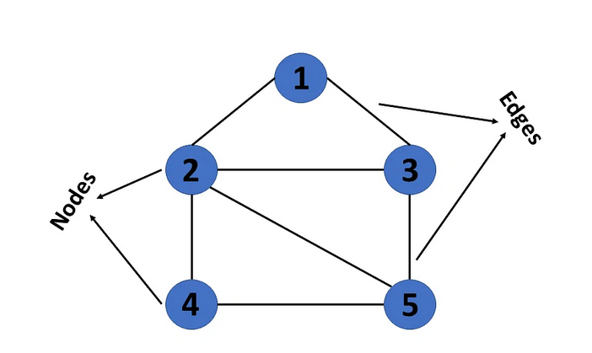
Another example graph
This graph has a set of vertices V= { 1,2,3,4,5} and
a set of edges E= { (1,2),(1,3),(2,3),(2,4),(2,5),(3,5),(4,5 }.

Slide 5
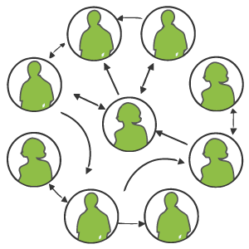
Graph examples in real-world
Web pages with links
Methods in a program that call each other
Road maps (e.g., Google maps)
Airline routes
Facebook friends
Course pre-requisites
Family trees
Paths through a maze

Slide 6
Paths
path: A path from vertex a to b is a sequence of edges that can be followed starting from a to reach b.
Path can be represented as vertices visited, or edges taken
example, one path from V to Z: {b, h} or {V, X, Z}
path length: Number of vertices or edges contained in the path.
neighbor or adjacent: Two vertices connected directly by an edge.
example: X is a neighbor or adjacent to V
V
a
b
U
d
X
Z
h
c
e
W
g
f
Y

Slide 7
Reachability, connectedness
V
reachable: Vertex V is reachable from Y if a path exists from V to Y.
connected: A graph is connected if every vertex is reachable from any other vertex.
Is the graph at top right connected?
Ans: Yes
strongly connected: When every vertex has an edge to every other vertex. This is also known as complete graph.
a
b
U
d
X
Z
h
c
e
W
g
f
Y
a
b
Note: A complete graph with n nodes will have n*(n-1)/2 edges
c
d

Slide 8
Disconnected Graph
If every vertex is not reachable in a graph, then that graph is called as
Disconnected graph.
a
b
d
c
e

Slide 9
Loops and cycles
cycle: A path that begins and ends at the same node.
example1: V-> X-> Y-> W->U->V.
example2: U->W->V->U
acyclic graph: One that does not contain any cycles.
loop: An edge directly from a node to itself.
Many graphs don't allow loops.
V
a
b
U
d
X
Z
h
c
e
W
g
f
Y

Slide 10
Weighted graphs
weight: Cost associated with a given edge.
Some graphs have weighted edges, and some are unweighted.
Edges in an unweighted graph can be thought of as having equal weight (e.g. all 0, or all 1, etc.)
Most graphs do not allow negative weights.
example: graph of airline flights, weighted by miles between cities:
849
PVD
1843
ORD
SFO
142
802
LGA
1743
337
1387
HNL
2555
1099
LAX
1233
DFW
1120
MIA

Slide 11
Directed graphs
Directed graph (or digraph): where edges are one-way connections between vertices.
If graph is directed, a vertex has a separate in/out degree.
A digraph can be weighted or unweighted.
Is the graph below connected? Why or why not?
a
b
c
d
e
f
g

Slide 12
Some Graph Terminology
Types of Edges:
- Undirected Edge: This type of edge is a bidirectional edge, i.e., data flows or one can traverse in both directions.
- Directed Edge: This type of edge is a unidirectional edge, i.e., data flows or one can traverse in one direction.
- Weighted Edge: A weighted edge is an edge with a cost on it.
Degree of a node: It is the number of edges connected to a node is called degree of a node.
Indegree of a node: Total number of incoming edges connected to a node is called indegree of a node.
Outdegree of a node: Total number of outgoing edges from a node is called outdegree of a node

Slide 13
Some Graph Terminology (Cont…)
End vertices or Endpoints: The two vertices joined by an edge are called the end vertices (or endpoints) of an edge.
Origin (or Source): If there is a path in a graph , its first endpoint is said to be an origin or a source.
Destination: If there is a path in a graph , the last endpoint is said to be the destination.
Parallel or Multiple Edges: If there are two undirected edges with the same source and destination vertices, then these edges are said to be parallel or Multiple edges.
Self loop: An edge (directed or undirected) is a self loop if its both source and destination vertices are same.
Incident: An edge is said to be incident on a vertex if the vertex is one of the endpoints of an edge.

Slide 14
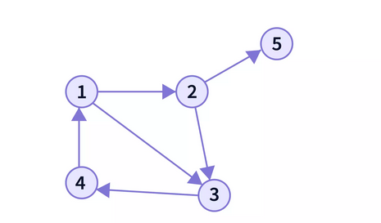
Types of Graphs
1. Directed Graphs: A graph with directed edges is said to be a directed graph.

Slide 15
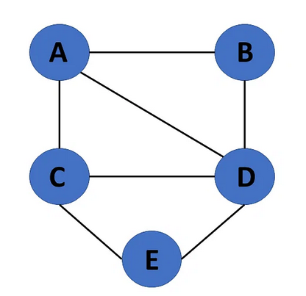
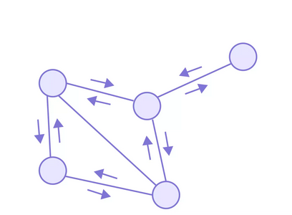
2. Undirected Graphs
A graph with undirected edges is said to be a Undirected Graph.

Slide 16
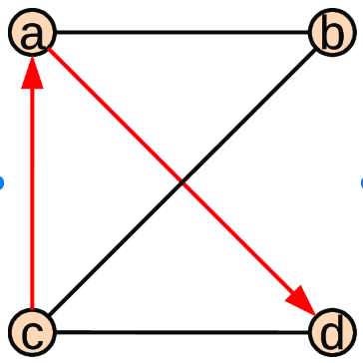
3. Mixed Graph
A graph with a combination of both directed and undirected edges is said to be mixed graph.

Slide 17
Graph Representations
A graph can be represented by using any one of the following:
Adjacency Matrix
Adjacency List (Linked List)

Slide 18
1. Graph Representation using Adjacency Matrix
The adjacency matrix A for a graph G=(V, E) with n vertices, is an nxn matrix of bits, such that
Aij= 1, if there is an edge from Vi to Vj
and Aij= 0, if there is no such edge.
We can also write the above as
A(i, j) = 1 if and only if edge (Vi , Vj ) is in EG
0 , otherwise

Slide 19
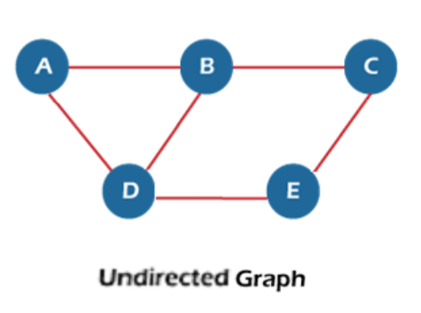
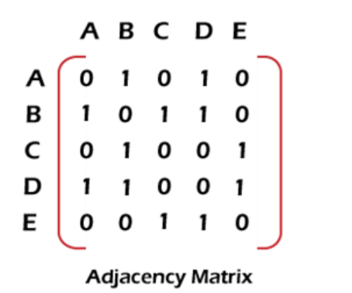
1. Example Adjacency Matrix for undirected Graph

Slide 20
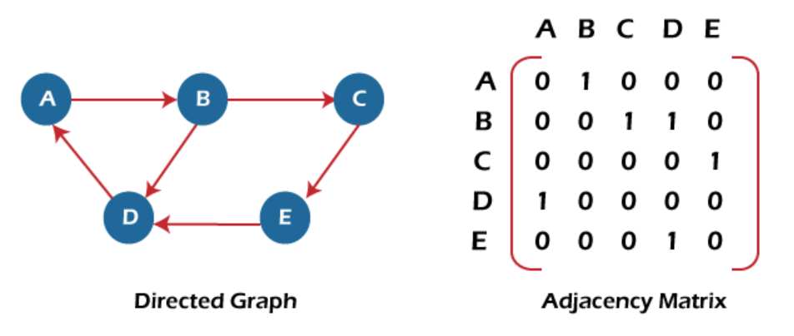
1. Adjacency Matrix for a directed Graph

Slide 21
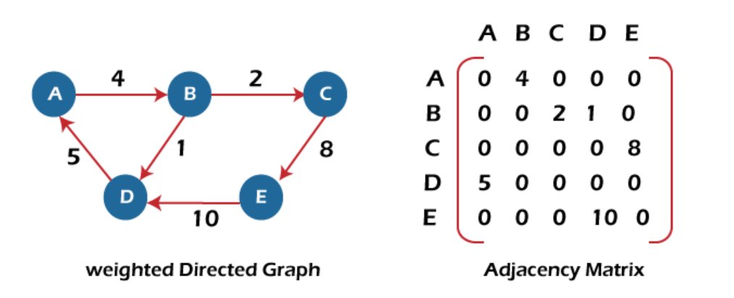
1. Adjacency Matrix for a weighted directed Graph

Slide 22
When to use Adjacency Matrix
It should be used when the graph is dense and a number of edges are large s because it stores all possible connections explicitly.

Slide 23
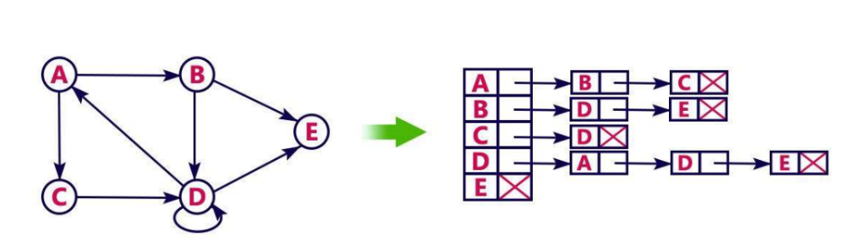
2. Graph Representation using Adjacency List (Linked List)
An adjacency list can also be used to store the Graph in the computer's memory.
In this type of representation, every vertex of graph contains list of its adjacent vertices.
For example:

Slide 24
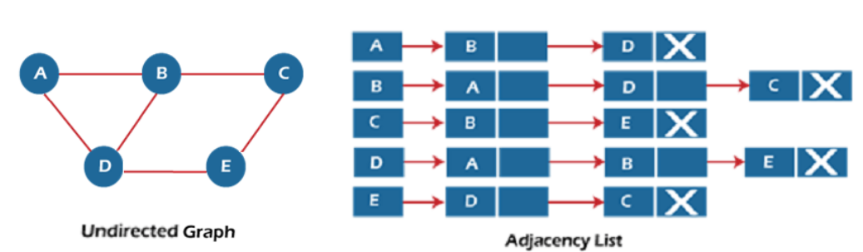
2. Adjacency List representation for an undiected Graph
Note1: The sum of the lengths of adjacency lists is equal to twice the number of edges present in an undirected graph.

Slide 25
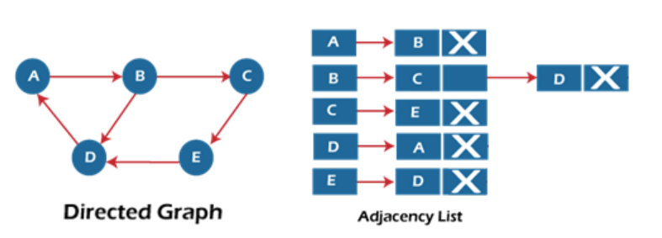
2. Adjacency List representation for a diected Graph
Note: For a directed graph, the sum of the lengths of adjacency lists is equal to the number of edges present in the graph.

Slide 26
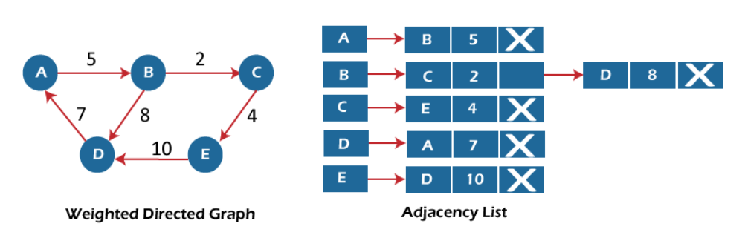
2. Adjacency List representation for a weighted diected Graph
Note: For a directed graph, the sum of the lengths of adjacency lists is equal to the number of edges present in the graph.

Slide 27
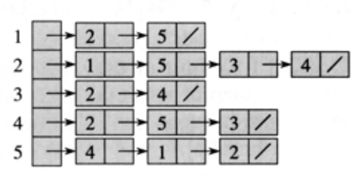
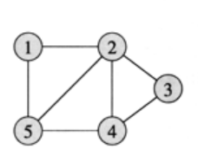
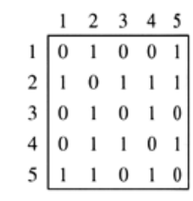
Graph Representation using Adjacency Matrix and Adjacency List
Undirected Graph
Adjacency Matrix
Adjacency List (Linked List)

Slide 28
Graph Traversals
Graph traversal means visiting each node of a graph once without entering into any loops.
Traversal can be used to search for a node in a graph
Graph traversal can also be used to decide the order of the vertices to be visited in the search process.

Slide 29
Graph Traversals (Cont…)
Visiting a graph is same like in the tree but in graph, there is a chance to visit a node more than once. To avoid this, we need to keep track of visited nodes and unvisited nodes.
A visited array (Boolean) needs to be maintained to mark the visited vertices.
There are two graph traversal methods:
Breadth First Traversal (BFS)
Depth First Search (DFS)
The above methods can be used to traverse data structures: Graphs and Trees. The algorithm starts at the given node or random node in the case of a graph and in the case tree, the algorithm starts at root node.

Slide 30
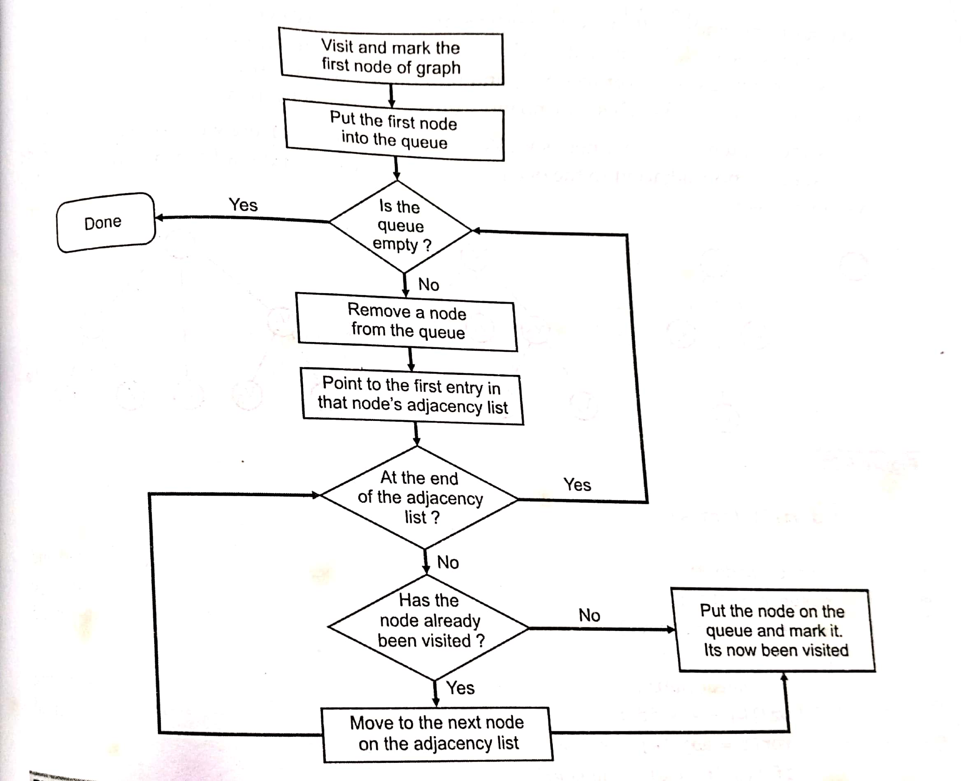
1. Breadth-First Search Process Flow(BFS)
Note: BFS uses Queue data structure

Slide 31
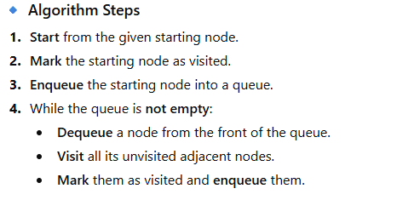
Algorithm for Breadth First Search

Slide 32
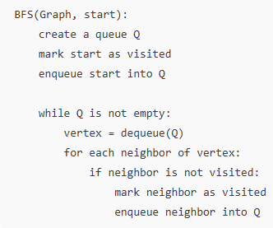
Pseudocode of BFS

Slide 33
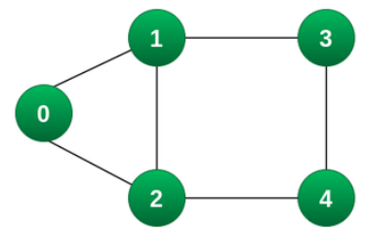
BFS Traversal Example
Consider the below graph is given and you are asked to traverse it using BFS starting from the node 0.

Slide 34
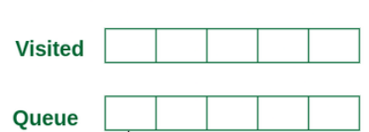
BFS Traversal
Step 1: Initially queue and visited arrays are empty.

Slide 35
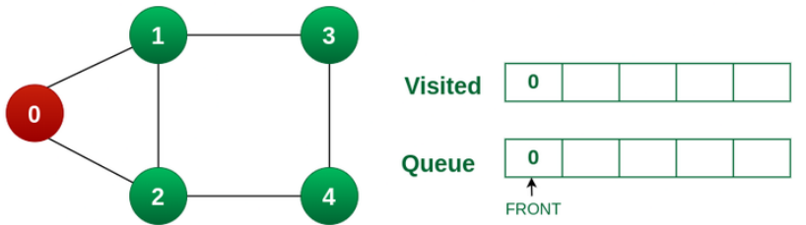
BFS Traversal
Step 2: Push node 0 into queue and mark it visited.

Slide 36
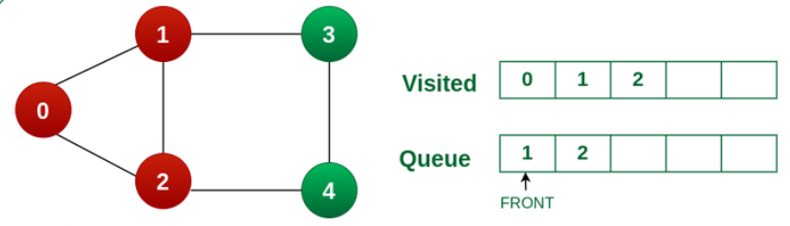
BFS Traversal
Step 3: Remove node 0 from the front of queue and visit the unvisited neighbours and push them into queue.
Output
0

Slide 37
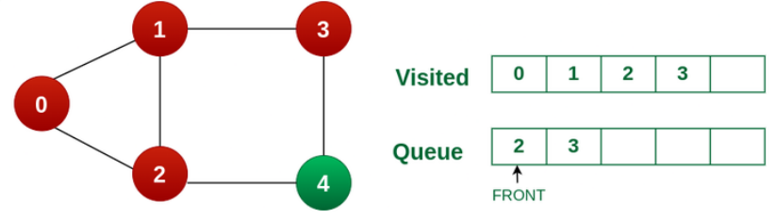
BFS Traversal
Step 4: Remove node 1 from the front of queue and visit the unvisited neighbors and push them into queue.
Output
0
1

Slide 38
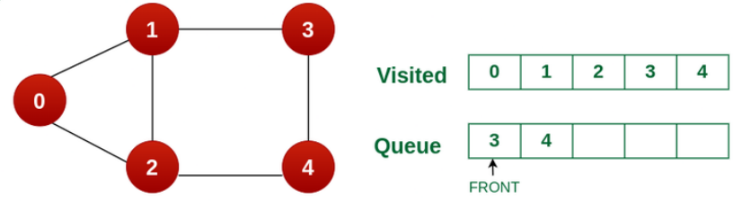
BFS Traversal
Step 5: Remove node 2 from the front of queue and visit the unvisited neighbours and push them into queue.
Output
0
1
2

Slide 39
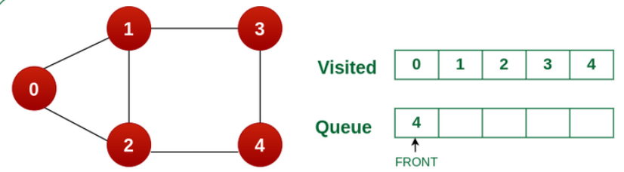
BFS Traversal
Step 6: Remove node 3 from the front of queue and visit the unvisited neighbors and push them into queue.
Observe that every neighbors of node 3 is already visited, so move to the next node that are in the front of the queue.
Output
0
1
2
3

Slide 40
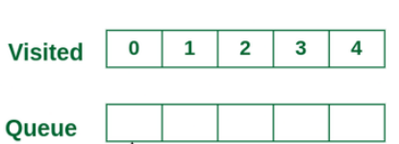
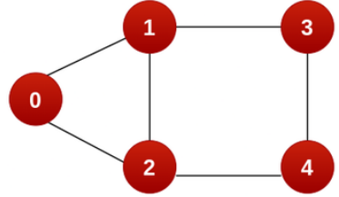
BFS Traversal
Output
0
1
2
3
4
Step 7: Remove node 4 from the front of queue and visit the unvisited neighbours and push them into queue.
Observe that every neighbours of node 4 are visited, so move to the next node that is in the front of the queue.
Note: Queue becomes empty here, So, we terminate these process of BFS traversal.

Slide 41
Time complexity of BFS
If adjacency list is used for implementation of graph: O(V+E)
If adjacency matrix is used for implementaion of graph: O(V^2)

Slide 42
Applications of BFS
Finding the shortest path in an unweighted graph
Web crawlers (searching level by level)
Social networking (finding friends of friends)
Network broadcasting
AI search algorithms in games and puzzles

Slide 43
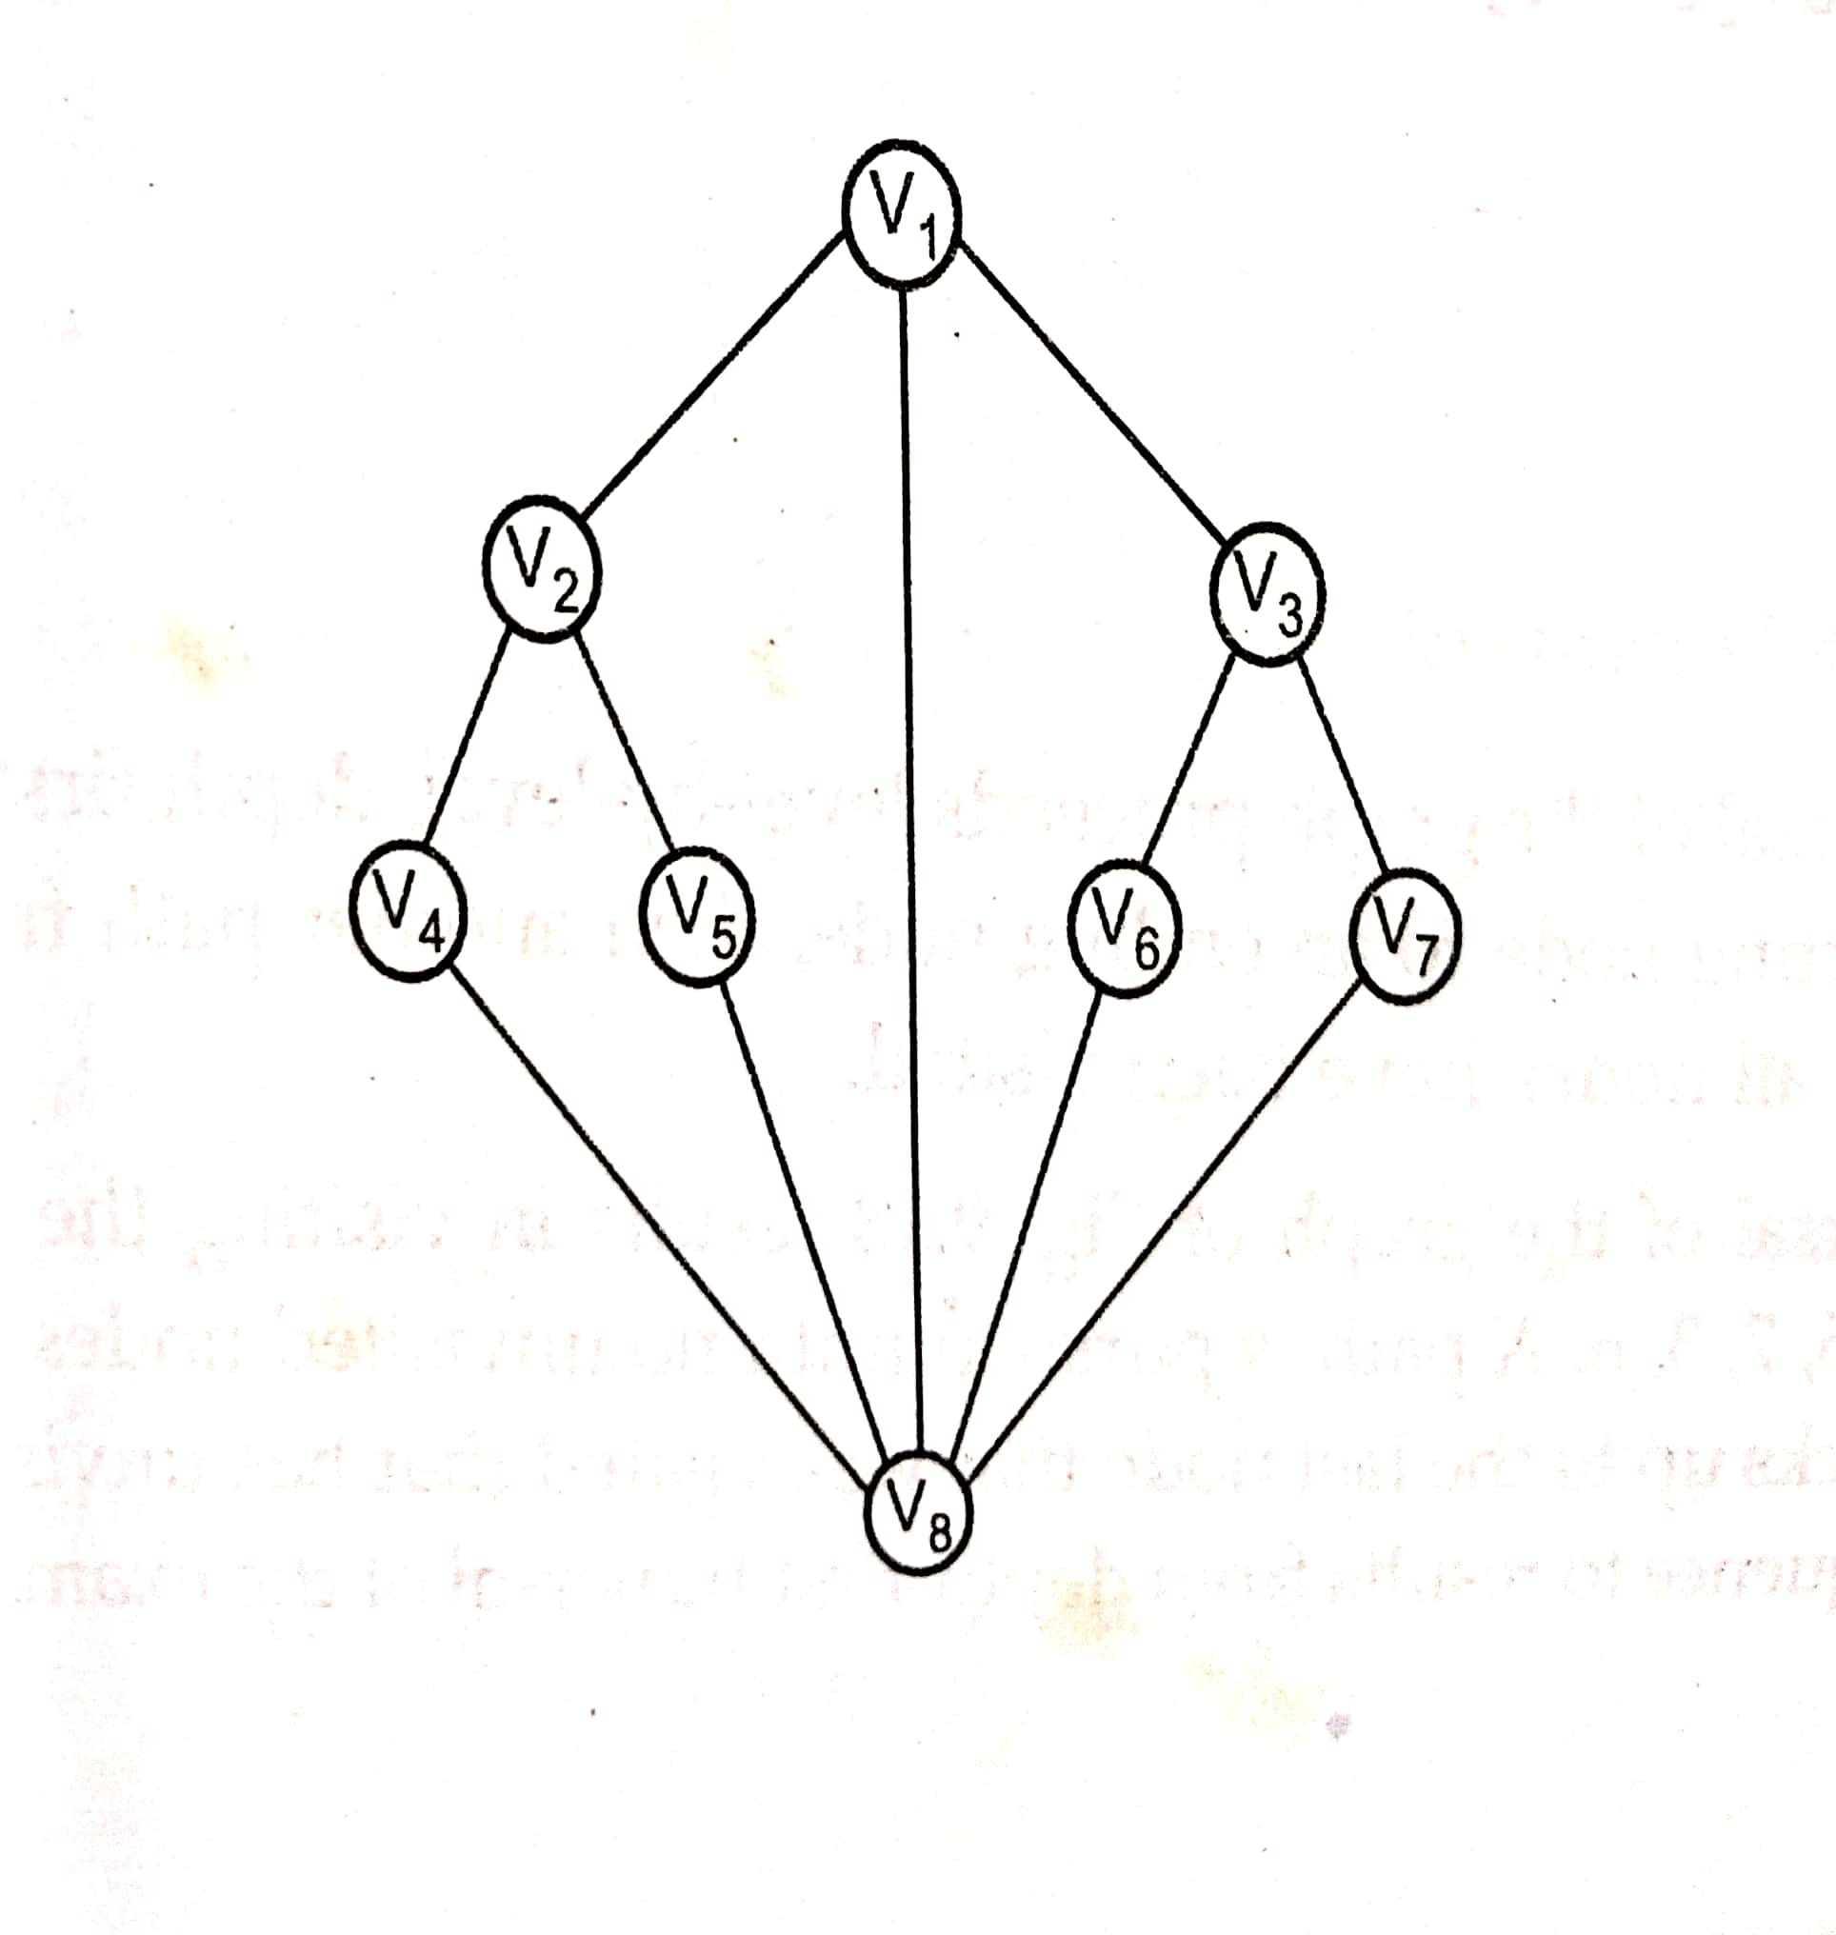
Homework:1 Display the nodes visited on the below graph using BFS
Starting node is V1

Slide 44
BFS Expected Output (Homework1)
V1, V2, V8, V3, V4, V5, V6, V7.
The above is the order of the nodes visited in the graph using BFS

Slide 45
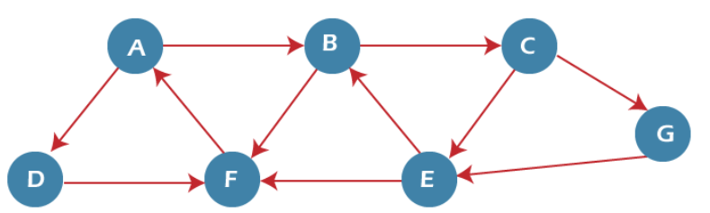
Homework2: Display the nodes visited on the below graph using BFS
Starting node is A
Reference Link: https://www.javatpoint.com/breadth-first-search-algorithm

Slide 46
BFS Output (Homework2)
A, B, D, C, F, E, G
The above is the order of the nodes visited in the graph using BFS

Slide 47
Depth-First Search (DFS)
Breadth first traversal of the graph proceeds level-by-level
The DFS algorithm starts at the root node (selecting some arbitrary node as the root node in the case of a graph) and explores as far as possible along each branch before backtracking.
It uses the Last In-First-Out (LIFO) strategy and hence it is implemented using a stack data structure.
As DFS traverses the tree “deepest node first”, it would always picks the deeper branch until it reaches the solution (or it runs out of nodes, and goes to the next branch).

Slide 48
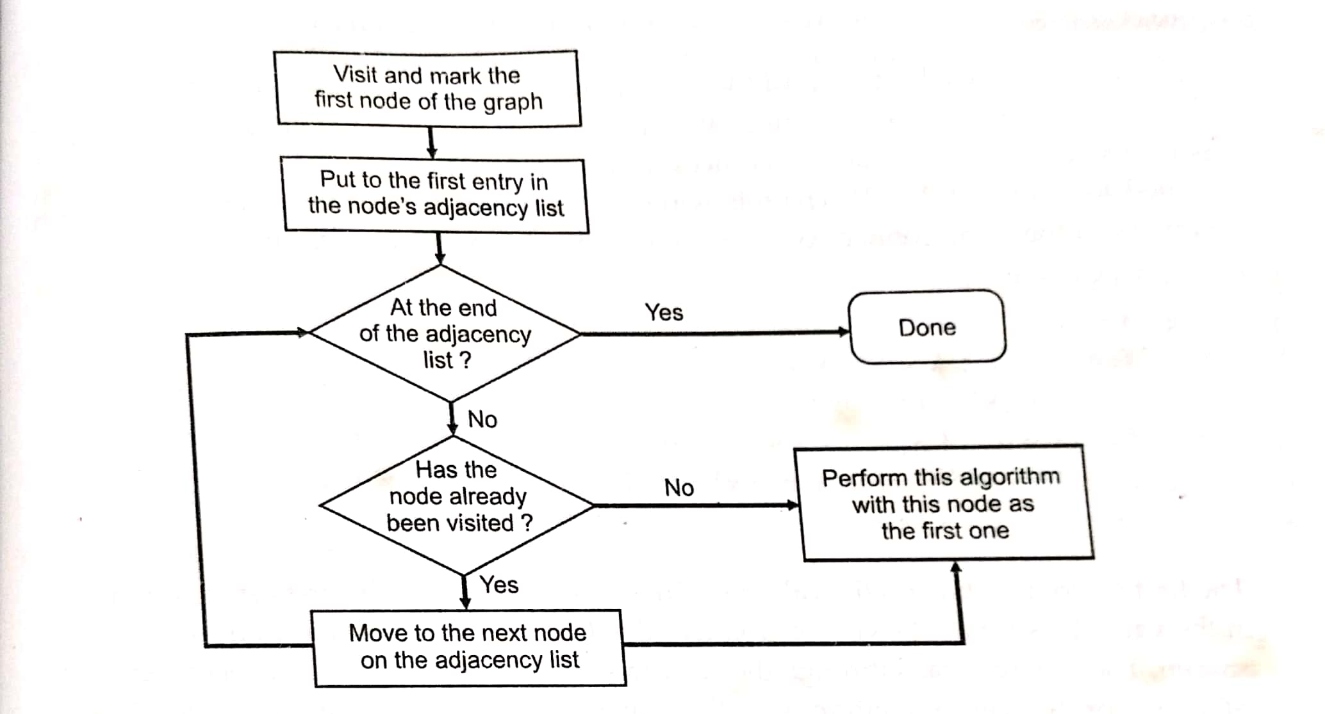
Process flow of Depth-First Search (DFS)
Note: DFS uses Stack data structure

Slide 49
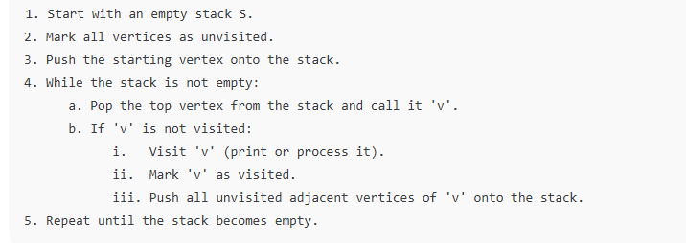
DFS Algorithm Steps

Slide 50
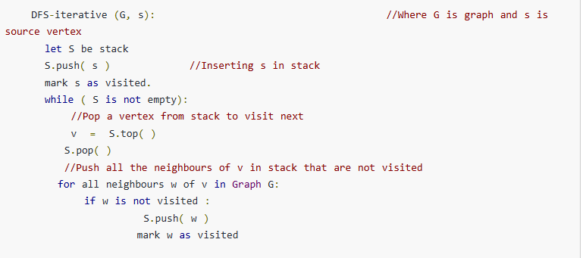
Pseudo code of DFS

Slide 51
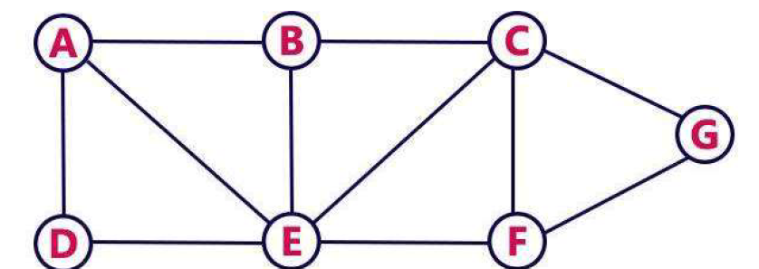
Traverse vertices of the below graph using DFS

Slide 52
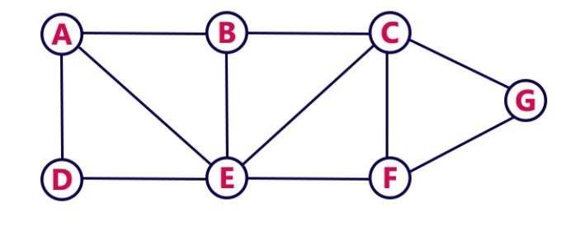
Depth First Search
DFS traversal of a graph produces a spanning tree as a result
Spanning Tree is a graph without loops
Consider the Following Example

Slide 53
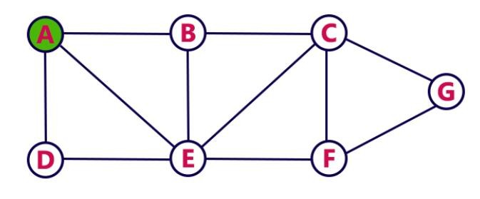
Depth First Search- STEP1
Choose the Starting Vertex as A
VISIT A
Push A into the Stack
A
RESULT: A
STACK

Slide 54
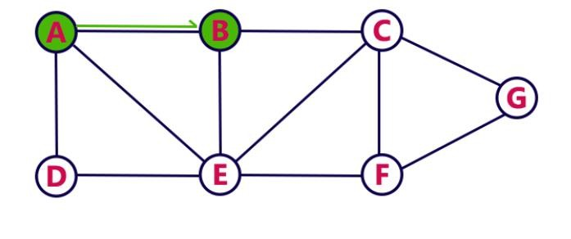
Depth First Search- STEP 2
Visit any adjacent vertex of A which is not visited ( taken B)
VISIT B
Push newly visited B into the Stack
B
A
RESULT: A B
STACK

Slide 55
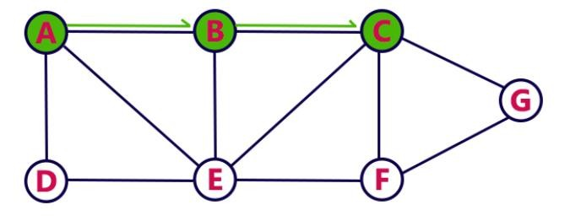
Depth First Search- STEP 3
Visit any adjacent vertex of B which is not visited ( taken C)
VISIT C
Push newly visited C into the Stack
C
B
A
RESULT: A B C
STACK

Slide 56
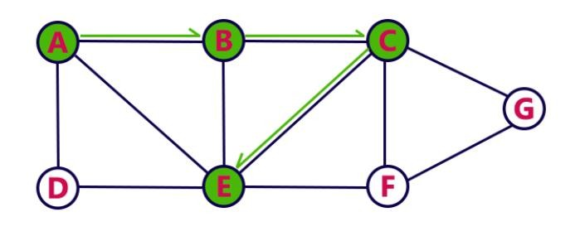
Depth First Search- STEP 4
Visit any adjacent vertex of C which is not visited ( taken E)
VISIT E
Push newly visited E into the Stack
E
C
B
A
RESULT: A B C E
STACK

Slide 57
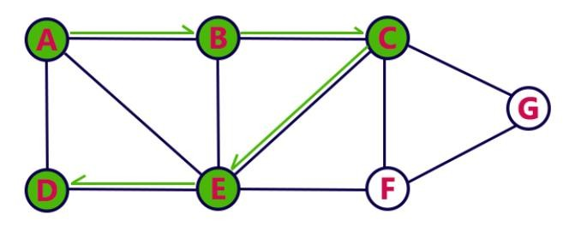
Depth First Search- STEP 5
Visit any adjacent vertex of E which is not visited ( taken D)
VISIT D
Push newly visited D into the Stack
D
E
C
B
A
RESULT: A B C E D
STACK

Slide 58
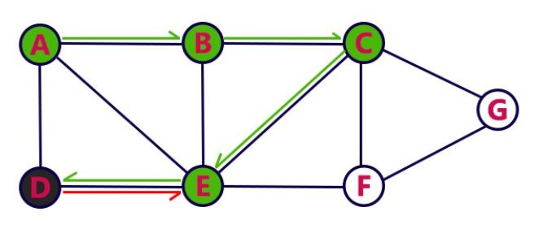
Depth First Search- STEP 6
No new vertex to be visited from D
POP D
E
C
B
A
RESULT: A B C E D
STACK

Slide 59
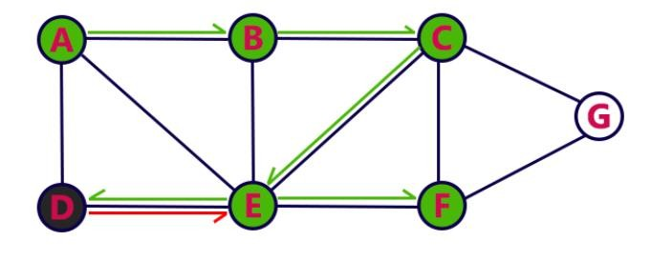
Depth First Search- STEP 7
Visit any adjacent vertex of E which is not visited ( taken F)
VISIT F
Push newly visited F into the Stack
F
E
C
B
A
RESULT: A B C E D F
STACK

Slide 60
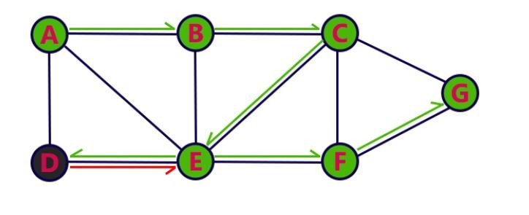
Depth First Search- STEP 8
Visit any adjacent vertex of F which is not visited ( taken G)
VISIT G
Push newly visited G into the Stack
G
F
E
C
B
A
RESULT: A B C E D F G
STACK

Slide 61
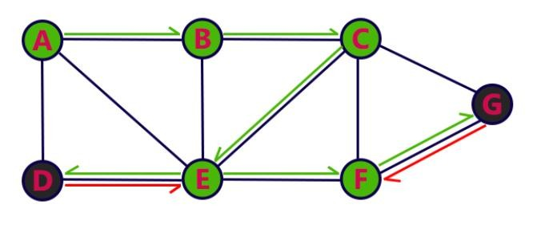
Depth First Search- STEP 9
No new vertex to be visited from G
POP G
F
E
C
B
A
RESULT: A B C E D F G
STACK

Slide 62
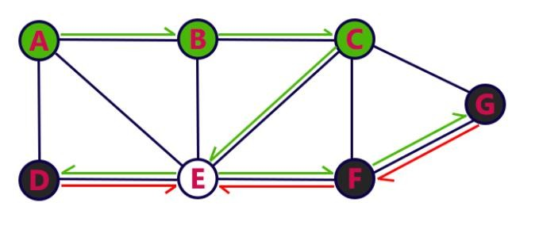
Depth First Search- STEP 10
No new vertex to be visited from F
POP F
E
C
B
A
RESULT: A B C E D F G
STACK

Slide 63
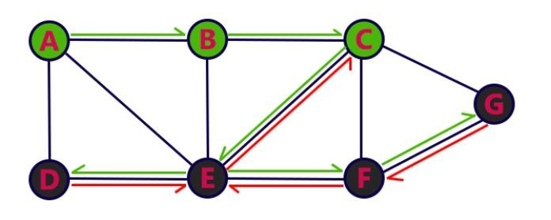
Depth First Search- STEP 11
No new vertex to be visited from E
POP E
C
B
A
RESULT: A B C E D F G
STACK

Slide 64
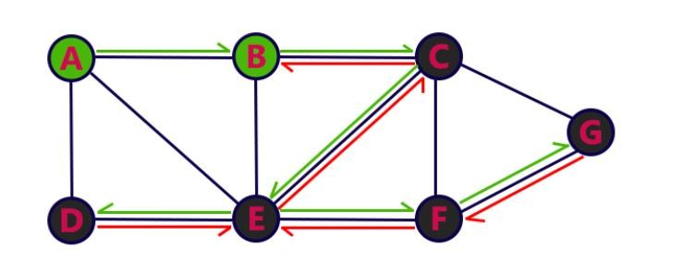
Depth First Search- STEP 12
No new vertex to be visited from C
POP C
B
A
RESULT: A B C E D F G
STACK

Slide 65
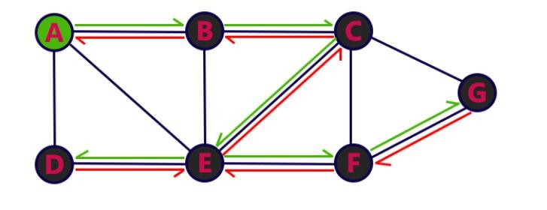
Depth First Search- STEP 13
No new vertex to be visited from B
POP B
A
RESULT: A B C E D F G
STACK

Slide 66
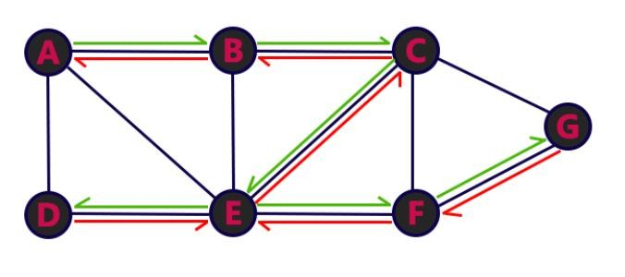
Depth First Search- STEP 14
No new vertex to be visited from A
POP A
RESULT: A B C E D F G
Stack Empty, End the DFS traversal
STACK

Slide 67

DFS Traversal - Result
A→B→C→E→D→F→G

Slide 68
Time complexity of DFS
If adjacency list is used for implementation of graph: O(V+E)
If adjacency matrix is used for implementaion of graph: O(V^2)

Slide 69

Differences between DFS and BFS way of traversing

Slide 70
Single Source Shortest Path Problem
This problem is to find shortest path with minimum distance (or cost) from a given source to all other vertices on a graph.
The edges of a graph can have negative weights or positive weights.
Dijkstra’s algorithm can be used to find shortest path with minimum distance (or cost) from a source to all other vertices on a graph that has only positive edge weights.
Dijkstra’s algorithm works on both directed and undirected graphs.

Slide 71
Dijkstra’s Algorithm
Purpose: It is a shortest path algorithm used to find the minimum distance from a given source vertex to all other vertices in a weighted graph, provided that all edge weights are non-negative.
Key Idea:
The algorithm maintains a set of vertices whose shortest distance from the source is known and repeatedly picks the vertex with the minimum tentative distance, updating the distances of its neighboring vertices.

Slide 72
Algorithm Steps
Let the graph have vertices V={1,2,3,...,n} and edges with non-negative weights
1. Initialization:
Set the distance of the source vertex to 0.
Set the distance of all other vertices to infinity (∞).
Mark all vertices as unvisited.
.

Slide 73

Algorithm Steps
3. Stop when all vertices are visited.
The array distance[] now holds the shortest distance from the source to all other vertices of the graph.

Slide 74
Variables and Arrays required for Dijkstra’s Algorithm
Declare two arrays − distance[] to store the distances from the source vertex to the other vertices in graph and visited[] to store the visited vertices.
Set distance[S] to ‘0’ and distance[v] = ∞, where v represents all the other vertices in the graph.
Add S to the visited[] array and find the adjacent vertices of S with the minimum distance.
The adjacent vertex to S, say A, has the minimum distance and is not in the visited array yet. A is picked and added to the visited array and the distance of A is changed from ∞ to the assigned distance of A, say d₁, where d₁ < ∞.
Repeat the process for the adjacent vertices of the visited vertices until the shortest path spanning tree is formed.
Notes:
Reference: Ref: https://www.tutorialspoint.com/design_and_analysis_of_algorithms/design_and_analysis_of_algorithms_dijkstras_shortest_path_algorithm.htm

Slide 75

Find the shortest path distance from node A to all other vertices

Slide 76

Dijkstra’s Example

Slide 77

Dijkstra’s Example

Slide 78

Dijkstra’s Example

Slide 79

Dijkstra’s Example

Slide 80

Dijkstra’s Example

Slide 81

Dijkstra’s Example

Slide 82

Dijkstra’s Example

Slide 83

Dijkstra’s Example

Slide 84

Dijkstra’s Example

Slide 85
Time Complexity
The time complexity of Dijkstra's algorithm is O((E+V)logV)), where V is the number of vertices and E is the number of edges

Slide 86

Homework: Dijkstra’s Algorithm
Find shortest path from S to other vertices

Slide 87

Graph with Negative Edge Costs
Graph with negative edges some edges in the graph have weights less than zero.
These negative weights can represent things like:
Discounts or gains in cost-based problems.
Energy recovery in physics simulations.
Profit in economic models.
Example graph with negative weights →

Slide 88
Significance of negative edge weights
If a cycle in graph whose total weight < 0, then we can keep looping and reduce the path cost infinitely. In such cases, shortest path is undefined. Hence, detection of negative cycle is important to tell if shortest path identification is possible or not.
Negative weights are useful for modeling real-world problems but require algorithms that can handle them (Bellman-Ford, Floyd-Warshall).
Note: Bellman-Ford and Floyd-Warshall’s algorithms are not in our syllabus. (so you don’t need to study about these algorithms for exam).

Slide 89
All Pairs Shortest Path Problems
The objective of this problem is to find the shortest path between every pair of vertices in a weighted graph.
Algorithms that solve All pairs shortest path problems:
- Floyd–Warshall Algorithm (This algorithm is Not in our syllabus, so you don’t need to study about this algorithm).

Slide 90
Topological Sorting
A topological sort or topological ordering of a directed ayclic graph is a linear ordering of its vertices such that for every directed edge (u,v) from vertex u to v, u comes before v in the ordering.

Slide 91
Topological Sorting (Cont…)
5
4
For example, a topological sorting
of the given graph is “5 4 2 3 1 0”.
There can be more then one
topological sorting for a graph.
For example , another
topological sorting for the graph
is “4 5 2 3 1 0”.The first vertex
in topological sorting is always
a vertex with in-degree as “0”
( a vertex with no incoming edges).
2
0
1
3
So, the Topological Sorting is NOT UNIQUE.
Also it can only be applied to Directed Acyclic Graphs(DAG).
91
Notes:
91

Slide 92
Directed Acyclic Graph
A directed acyclic graph is an acyclic graph that has a directions and should not contain any cycless.
4
Vertices Set: {1,2,3,4,5,6,7}
Edge Set: {(1,2),(1,3),(2,4), (2,5),(3,6),(4,7),
(5,7),(6,7)}
1
2
5
7
3
6
A directed acyclic graph has a topological ordering. This means that the
nodes are ordered so that the starting node has a lower value than the
ending node.
92
Notes:
92

Slide 93

Algorithm Steps for Topological Sorting
1
2
3
4
5
93
Notes:
93

Slide 94
Example
Identify nodes having in degree ‘0’
1
2
Select a node and delete it with its edges then add node to output
3
4
5
Select Node : 1
6
7
Output :
1
94
Notes:
94

Slide 95
Contd…
Identify nodes having in degree ‘0’
2
Select a node and delete it with its edges then add node to output
3
4
5
Select Node : 2
6
7
Output :
1
2
95
Notes:
95

Slide 96
Contd…
Identify nodes having in degree ‘0’
Select a node and delete it with its edges then add node to output
3
4
5
Select Node : 5
6
7
Output :
1
2
5
96
Notes:
96

Slide 97
Contd…
Identify nodes having in degree ‘0’
Select a node and delete it with its edges then add node to output
3
4
Select Node : 4
6
7
Output :
1
2
5
4
97
Notes:
97

Slide 98
Contd…
Identify nodes having in degree ‘0’
Select a node and delete it with its edges then add node to output
3
Select Node : 3
6
7
Output :
1
2
5
4
3
98
Notes:
98

Slide 99

Contd…
Identify nodes having in degree ‘0’
Select a node and delete it with its edges then add node to output
Select Node : 6
Select Node : 7
6
7
Output :
1
2
5
4
3
6
7
99
Notes:
99

Slide 100
Time Complexity:
The time complexity for topological sort is O(V + E), where V is the number of vertices and E is the number of edges in the graph.

Slide 101
Applications
1 Build Systems IDEs:
We have various IDE’s like Ecllipse , Netbeans etc. We have to build a project which has many libraries dependent on each
other then IDE uses Topological Sort to decide which library to
include or build first.
2 Advanced-Packaging Tool(apt-get) :
In Linux apt-get is used to install softwares in the system. The command
“apt-get install VLC” is used. It is the way in Linux to install and remove
softwares.
101
Notes:
101

Slide 102
Contd...
3 Task Scheduling :
Topological Sort is helpful in scheduling interdependent task to know which rask should proceed which one.
4 Pre- Requisite Problems:
We often come across situations where we need to finish one job in order to
proceed the next one. For ex, In University structure, we need to complete
basic Algorithm course to study an Advance Algorithm course. So, there
exist a pre- requisite and we can know this by doing a topological sort on all.
102
Notes:
102

Slide 103

Complete Graph
Definition:
Every vertex in a complete graph is adjacent to all other vertices.
A complete graph is denoted by the symbol K_n, where n is the number of vertices in the graph.
Example of complete graph with 5 verticests →

Slide 104
Characteristics of Complete Graph
Connectedness: A complete graph is a connected graph, which means that there exists a path between any two vertices in the graph.
Count of edges: Every vertex in a complete graph has a degree (n-1), where n is the number of vertices in the graph. So total edges are n*(n-1)/2.
Symmetry: Every edge in a complete graph is symmetric with each other, meaning that it is un-directed and connects two vertices in the same way.
Transitivity: A complete graph is a transitive graph, which means that if vertex A is connected to vertex B and vertex B is connected to vertex C, then vertex A is also connected to vertex C.
Regularity: A complete graph is a regular graph, meaning that every vertex has the same degree.

Slide 105
Time Complexity of Spanning Trees using Kruskal’s and Prim’s Algorithm
Time complexity of the Kruskal algorithm is O(E logE) or O(V logV).
Time complexity of Prim's algorithm is O(V²). But if Fibonacci heaps are used, the prim’s algorithm’s time complexity can be improved to O(E log V)
Kruskal’s and Prim’s algorithm works well on undirected graph.

Slide 106
References
Ellis Horowitz, Sartaj Sahni, Susan Anderson Feed, Fundamentals of Data Structures in C, Universities Press (India) Ltd.
Amiya Kumar Rath, Alok kumar Jagadev, “Data Structures Using C”, 2nd edition, SCITECH
B. A. Forouzan and R. F. Gilberg, Computer Science: A Structured Programming Approach Using C, 3/e, Cengage Learning, Third Edition
Online sources: GeeksforGeeks, Tutorialpoint, JavatPoint, etc.
https://www.slideshare.net/slideshow/topological-sorting-141291954/141291954

